Slide 1
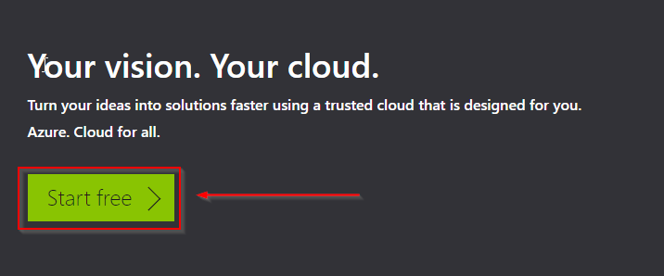
Creating Microsoft Azure Account
The following are the steps involved in creating an Azure account:
Step 1: Go to https://www.azure.com and click on the Start free button
Step 2: Again, click on the Start free button

Slide 2
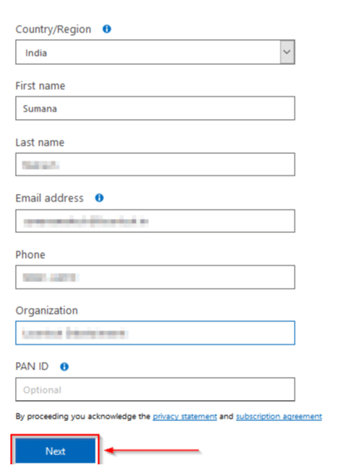
Step 3: If you already have a Microsoft account, enter your credentials and log in
Step 4: You will need to verify your account via phone SMS
Step 5: Provide your valid credit/debit card details, but you won’t be charged.
Step 6:Next, tick on I agree and click on Sign Up. Within a few seconds, your account will be ready.

Slide 3
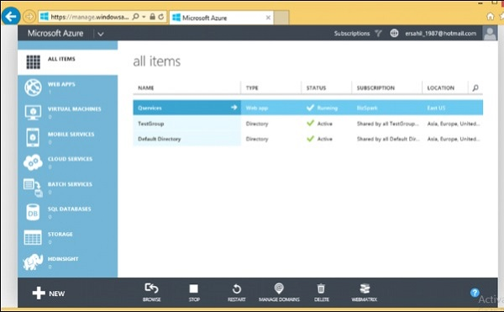
The dashboard of your Azure account

Slide 4
AZURE PRICING:
Azure Pricing is offered in the following three forms:
Pay as you go: As the name suggests, pay as you go lets you to pay only for what you use. For example, Let’s say you use a 64GB RAM machine with 8 CPU cores for 45 minutes. You will just be charged for 45 minutes, nothing more nothing less.
Spot Pricing or Low Priority VM: Azure has a lot of servers under the hood, sometimes because of low demand these servers can go idle, and for this very reason, Azure gives them at discount to users, which can up to 70%. There is a catch though, the moment demand goes up for these servers, they will be taken away from you. i.e. let’s say you took a Low Priority VM for 0.2 dollars an hour. The moment somebody bids a higher amount on that VM, it will be taken away from you. This kind of pricing is helpful when you are working on tasks that require processing, but they are not urgent. Therefore you do not mind, them being taken away from you.
Azure Reserved Instances: Unlike Low Priority VMs, this kind of pricing is for workloads, which are extremely important and require constant processing. The way it works is, you commit to Azure that you will be using a particular VM for let’s say 2 years. You cannot withdraw the VM mid-term. Once you have committed you will use the VM for a particular amount of time, you will be billed for the time that you committed for, even though you are not using it.

Slide 5
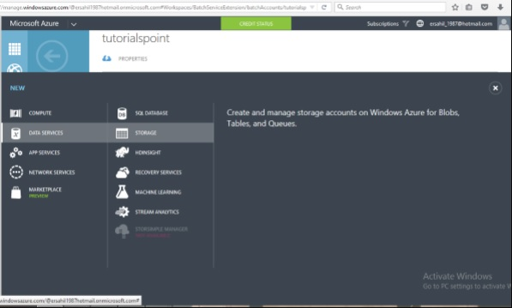
SETTING UP MICROSOFT AZURE STORAGE ACCOUNT:
Step 1 − When you login into your Azure account, you can find ‘Storage’ under ‘Data Services’.

Slide 6
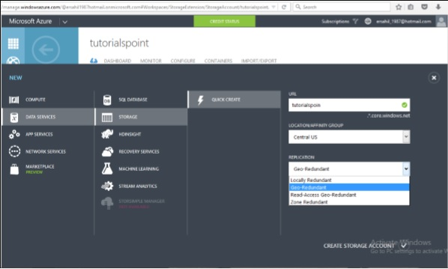
Step 2 − Click on ‘Quick Create’ and it will ask for ‘Account Name’.
You can see there are four options in the ‘Replication’ dropdown. A copy of the data is kept so that it is durable and available at high speed. It is retained even in case of hardware failure. There are different price plans for each replication option and the ‘Local Redundant’ is the cheapest of them all. So, choosing the replication of data depends on the cost and individual requirements.

Slide 7
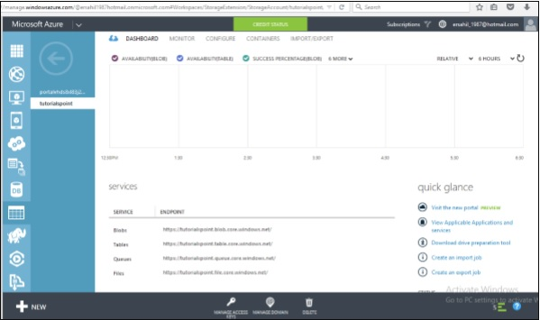
Storage Account Endpoints
Step 1 − Click on the ‘Storage Account’ it will take you to the next screen.
Step 2 − Click on ‘Dashboard’ from top horizontal menu.
There will a unique URL for each object. For example, account name is ‘example’ then the default URL for blob is https://example.blob.core.windows.net. Similarly, replace blob with table, queue and file in the URL to get the respective URLs. To access an object in the location is appended in the URL as http://example.blob.core.windows.net/container1/blob1

Slide 8
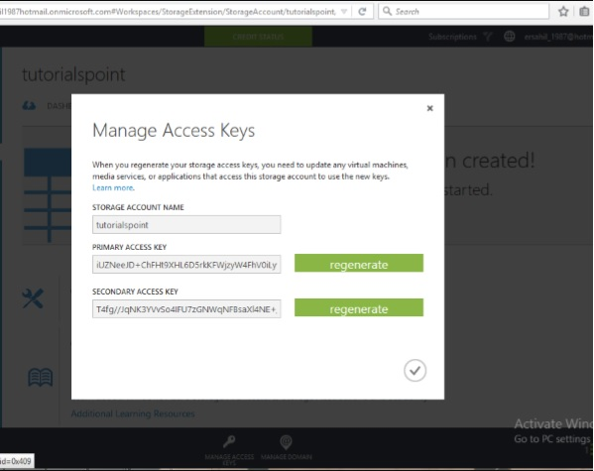
Generating an Access Key
Access key is used to authenticate the access to the storage account. Two access keys are provided in order to access the account without interrupting it, in case, one key has to be regenerated.
To get the Access Keys, click on ‘Manage Access Keys’ in your storage account. The following screen will come up.
Regenerating the key at regular intervals is advised for security reasons.

Slide 9
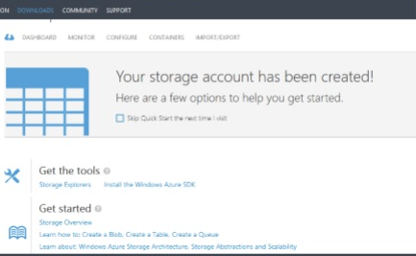
ACCESSING DATA IN AZURE:
There are many ways to do upload or download data but it can’t be done within the Azure portal itself. You will have to either create your own application or use an already built tool.
There are many tools available for accessing the data in an explorer that can be accessed by clicking on ‘Storage Explorer’ under ‘Get the Tools’ in your Azure storage account. Alternatively, an application can also be built using SDK available in Windows Azure Portal.
PowerShell commands is another approach to upload data.

Slide 10
ADVANTAGES:
Cost efficient:
Azure solutions don’t just make it faster and easier to add and scale infrastructure, they make it cheaper. Physical services and infrastructure devices like routers, load balancers and more quickly add up to thousands or even hundreds of thousands of dollars. Then there’s the IT expertise required to run this equipment, which amounts to major payroll overhead. By leveraging Microsoft’s massive infrastructure and expertise, Azure can trim our annual IT budget by head-turning percentages.
Flexibility
With Microsoft Azure you can spin up new services and geometrically scale your data storage capabilities on the fly. Compare this to a static data center, which would require new hardware and OS purchasing, provisioning, and deployment before additional power could be brought to bear against your IT challenges. This modern flexibility makes Azure a tempting solution for organizations of any size.

Slide 11
Applications
With a la carte service offerings like Visual Studio Team Services, Visual Studio Application Insights, and Azure’s scalable, on-demand storage for both frequently accessed and ‘cold’ data, Microsoft makes developing and testing mission-critical apps a snap. Move an application from test to production mode on the fly across a globally distributed network. Microsoft also offers substantial licensing discounts for migrating their existing apps to Azure, which represents even more opportunity for savings.
Disaster recovery
Sometimes the unthinkable becomes the very immediate reality. Another advantage of Microsoft Azure lay in its high-speed and geographically decentralized infrastructure, which creates limitless options for disaster recovery plans. Ensure that your critical application and data can run from redundant sites during recovery periods that last minutes or hours instead of days. Lost time is lost business, and with Azure you can guarantee continuous service delivery even when disaster strikes.

Slide 12
COMPARISON:
The combination of Microsoft’s vast infrastructure, constant application and services development, and powerful presence in the global IT marketplace has made Microsoft Azure solutions the choice of two-thirds of the world’s Fortune 500 companies. But the infinite scalability of Azure can make it just as right for your small personal business
AWS | Microsoft Azure | Google Cloud Platform
12 years old | 7 years old | 6 years old
Amazon S3 is mostly used for secondary backup | Backup is built into Azure | Does not provide any backup
Gives managed virtual tape infrastructure across hybrid environments | Enterprise-grade hybrid cloud storage | It relies on partners like Egnyte
Dominant market position | Second largest provider | Recently launched and new
Pricing is per hour | Pricing is per minute | Pricing is per minute

Slide 13
DISADVANTAGES:
Requires platform expertise:
One of the biggest issues seen with Azure is that it requires an expertise to operate so that all the required parts are functional. The over provision of cloud services is a common mistake made by business administrators. That simple mistake is not even easy to identify the cloud , thus costing thousands of dollars per year to the business.
Speed:
Speed can be an issue for some businesses.
Accessibility:
The ease of access may be problematic for some businesses.
Requires management:
Azure needs specific management with tools like patching and server monitoring. Sometimes, it also needs human resources to physically monitor the cloud-based data center and make sure that all things are smooth in action.

Slide 14
APPLICATIONS
Microsoft Azure is usually misinterpreted as just a hosting solution, but there is a lot more that can be done using Windows Azure.
It provides a platform to develop applications using a range of available technologies and programming languages.
It offers to create and deploy applications using .net platform, which is Microsoft’s own application development technology. In addition to .net, there are many more technologies and languages such as Java, PHP, Ruby, Oracle, Linux, MySQL, Python are supported
Microsoft Azure applications are scaled by creating multiple instances of the application. The number of instances needed by the application is specified by the developer while hosting the applications.
A new feature called ‘webjobs’ is available, which is a kind of batch processing service.
Azure platform is developed in such a way that developers need to concentrate on only the development part and need not worry about other technical stuff outside their domain. Thus most of the administrative work is done by Azure itself.
A marketplace is also set by Azure where its customers can buy applications and services. It is a platform where customers can search applications and deploy them in an easier way.

